Slide 1


Atliq Hardware
CONSUMER GOODS AD-HOC INSIGHTS
Presented By : Saurabh Pundkar

Slide 2
OVERVIEW
💻Atliq Hardware is a prominent computer hardware producer based in India, holding a leading position not only in the Indian market but also in various other countries.
PROBLEM
The management has identified the need for improved data insights to make informed decisions.
CHALLENGE
The company has 10 unexpected requests for which it requires insights.
APPROACH
Run SQL query to answer these requests, convert the data into visualizations, and present the insights to the top level management.
Tools used : MySQL, Tableau

Slide 3
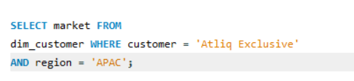
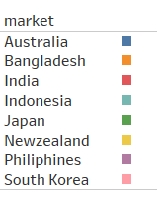

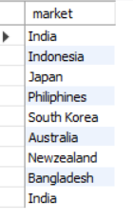
AD-HOC REQUESTS
Request - 1
Provide the list of markets in which customer "Atliq Exclusive" operates its business in the APAC (Asia Pacific) region.
INSIGHTS
In the APAC region , Atliq Exclusive store has solidified
its position in 8 key markets.

Slide 4
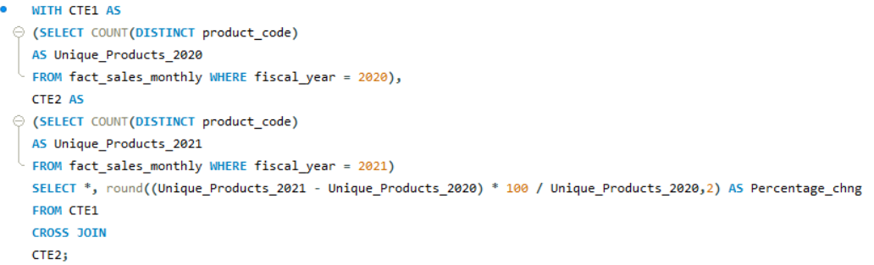
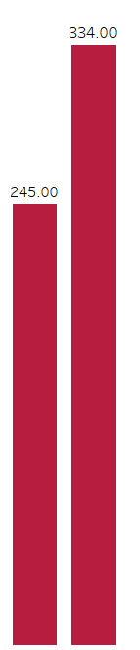
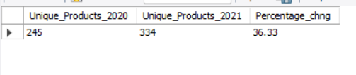
AD-HOC REQUESTS
Request – 2
What is the percentage of unique product increase in 2021 vs. 2020?
Unique products count 2021
Unique products count 2020
INSIGHTS
The Total Unique products count in the year 2020 was 245.
The Total Unique products count in the year 2021 was 334.

Slide 5
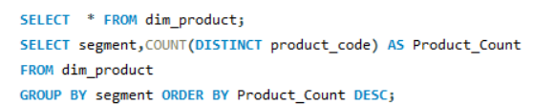
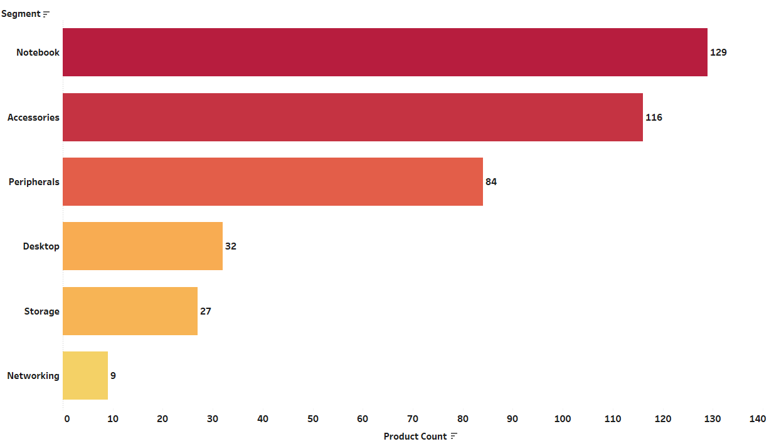
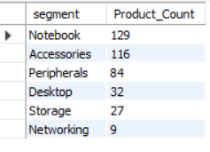
AD-HOC REQUESTS
Request – 3
Provide a report with all the unique product counts for each segment and sort them in descending order of product counts.
INSIGHTS
The Categories such as notebooks, accessories and peripherals
experiencing significant growth in manufacturing.
While the desktop, storage and networking requires exploration of current trends and demands for new products introductions.

Slide 6
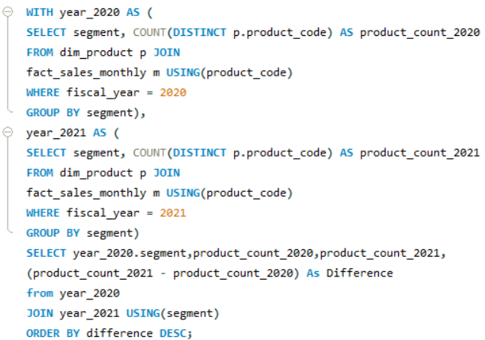
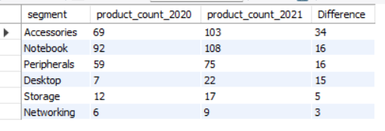
AD-HOC REQUESTS
Request – 4
Which segment had the most increase in unique products in 2021 vs 2020?

Slide 7
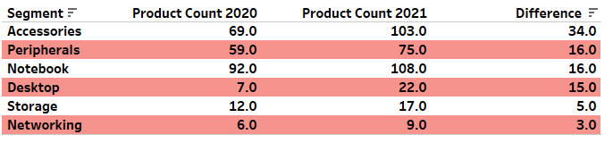
AD-HOC REQUESTS
Request – 4
Which segment had the most increase in unique products in 2021 vs 2020?
INSIGHTS
Notebook, accessories, peripherals and storage all experienced notable increase in product
count, ranging from approximately 17 % to over 49 %.
Desktop grew by 214 % indicates a notable increase in demand. However, the growth in storage and networking has a lesser emphasis and market demand.

Slide 8

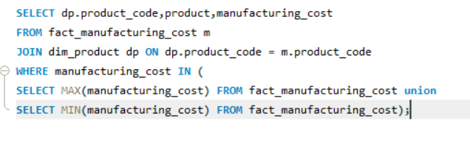


AD-HOC REQUESTS
Request – 5
Get the products that have the highest and lowest manufacturing costs.
Insights
Manufacturing cost : High(240.54)
Product: Personal Desktop
Product Code: AQ Home Allin1 Gen2
Variant: Plus 3
Manufacturing cost : Low (40.54)
Product: Mouse
Product Code: AQ Master wired x1 MS Gen2
Variant: Standard 1

Slide 9
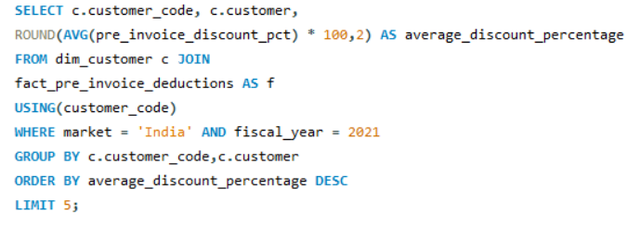
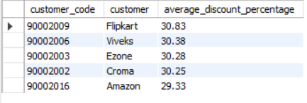
AD-HOC REQUESTS
Request – 6
Generate a report which contains the top 5 customers who received an average high pre_invoice_discount_pct for the fiscal year 2021 and in the Indian market.

Slide 10
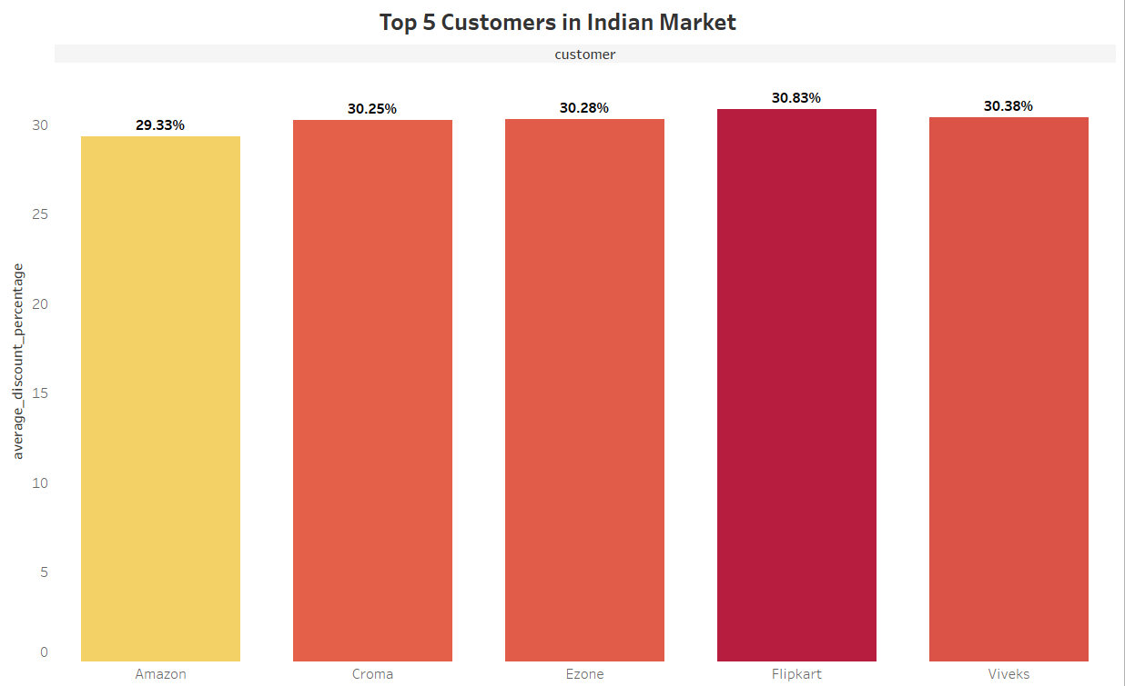
AD-HOC REQUESTS
Request – 6
Generate a report which contains the top 5 customers who received an average high pre_invoice_discount_pct for the fiscal year 2021 and in the Indian market.
INSIGHTS
The top 5 customers in India, with Flipkart offering the highest average discount contributing most to the sales, while Amazon contributing the least. The discount strategy seems to be effective for the company.

Slide 11
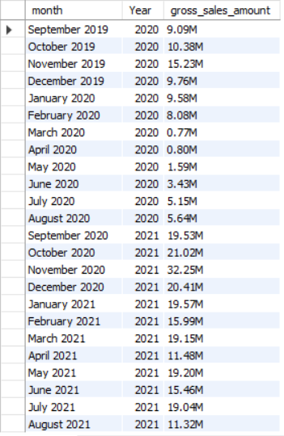
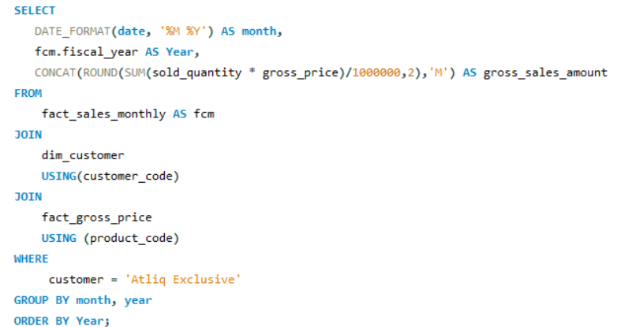
AD-HOC REQUESTS
Request – 7
Get the complete report of the Gross sales amount for the customer “Atliq Exclusive” for each month. This analysis helps to get an idea of low and high-performing months and take strategic decisions.

Slide 12
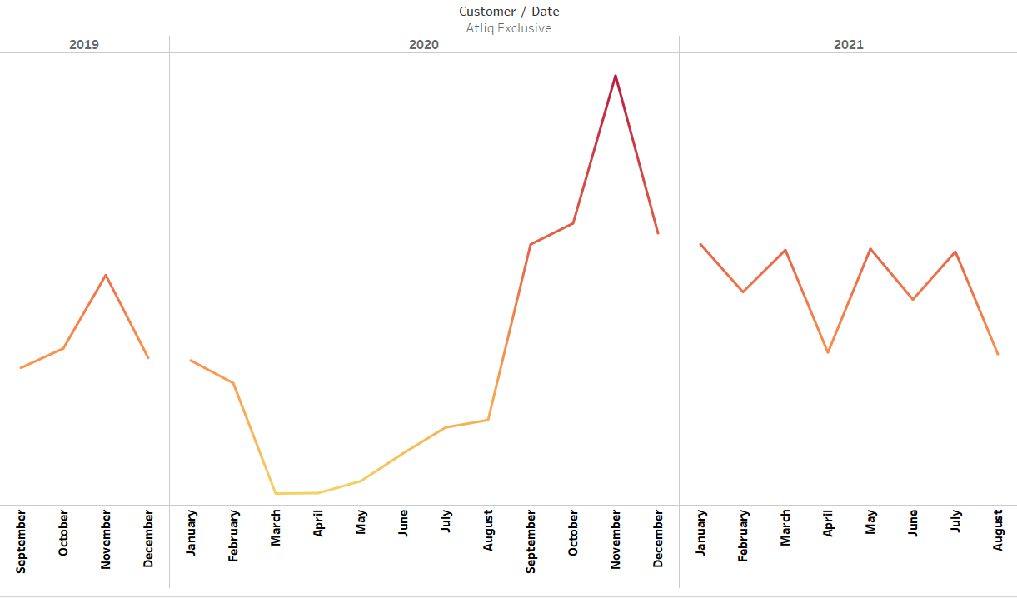
AD-HOC REQUESTS
Request – 7
Get the complete report of the Gross sales amount for the customer “Atliq Exclusive” for each month. This analysis helps to get an idea of low and high-performing months and take strategic decisions.
32 M
21 M
20 M
20 M
20 M
19 M
19 M
19 M
15 M
16 M
15 M
11 M
9 M
10 M
10 M
10 M
11 M
8 M
5M
6M
3M
1 M
1M
2M
INSIGHTS
Sales have shown consistent growth despite pandemic challenges. Lowest gross sales occurred in march 2020, Highest gross sales occurred in november 2020.
In year 2021 accounted for almost 74% of the total gross sales indicating substantial growth during that period.

Slide 13
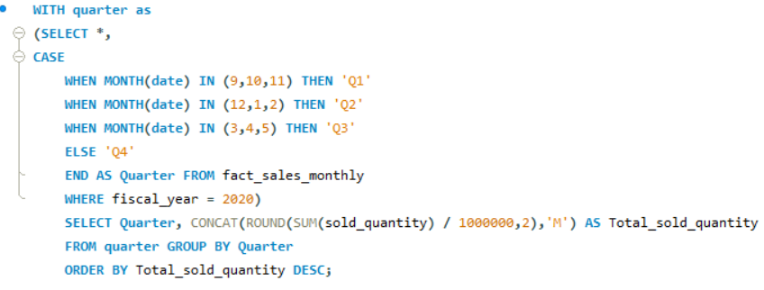
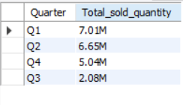
AD-HOC REQUESTS
Request – 8
In which quarter of 2020, got the maximum total_sold_quantity?

Slide 14
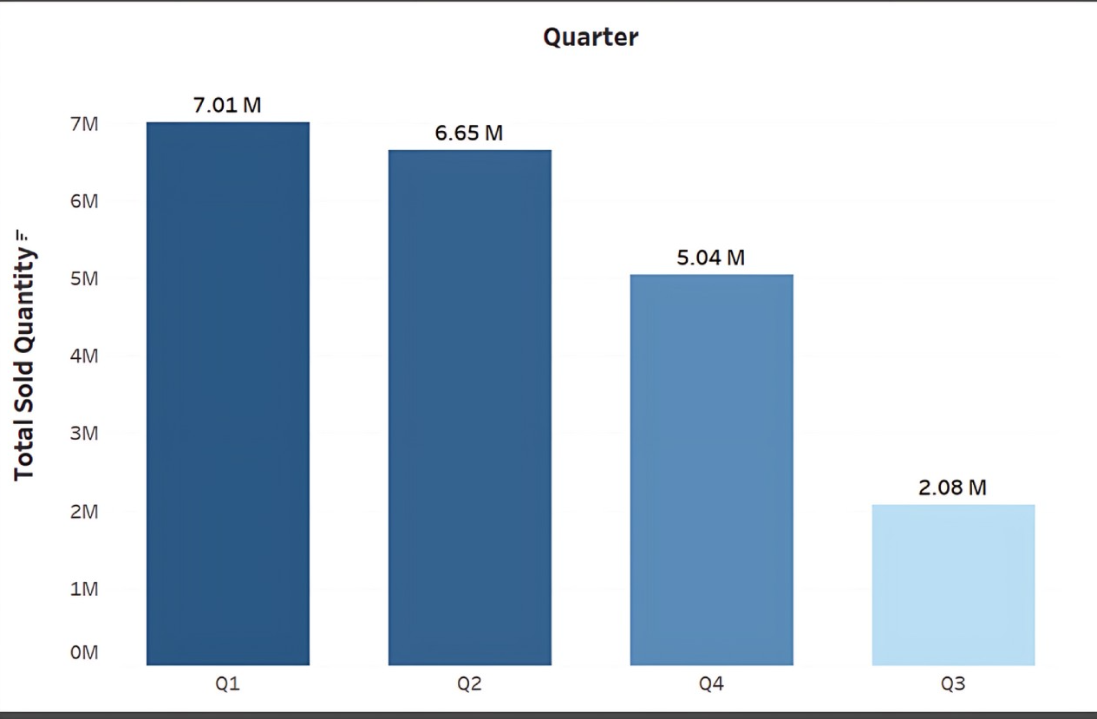
AD-HOC REQUESTS
Request – 8
In which quarter of 2020, got the maximum total_sold_quantity?
INSIGHTS
In Q1 FY 2020 had the highest units sold overall with 7.01 Million.
While the Q3 FY 2020 had the fewest units sold with 2.08 Million.

Slide 15
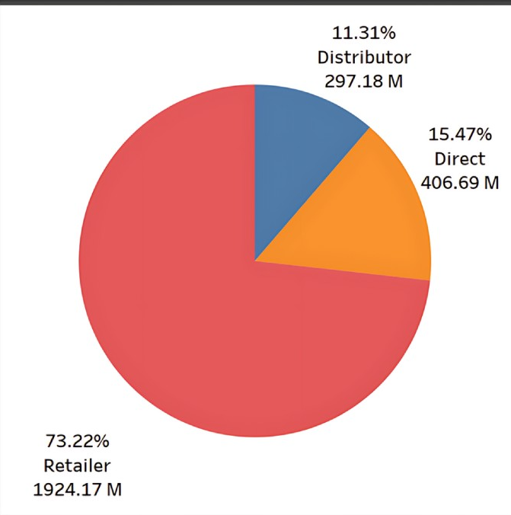
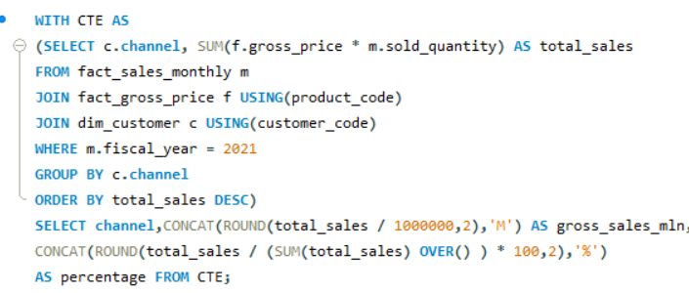

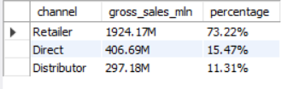
AD-HOC REQUESTS
Request – 9
Which channel helped to bring more gross sales in the fiscal year 2021 and the percentage of contribution?
INSIGHTS
Retailers dominated sales with 73.22% indicating their primary role in driving revenue.
Direct sales contributed 15.47% while distributors accounted for 11.31% highlighting their small but significant impact.

Slide 16
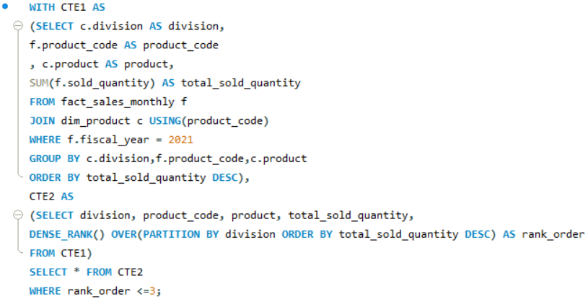
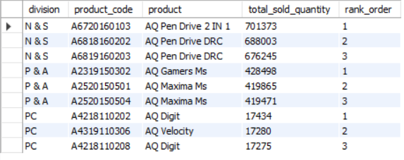
AD-HOC REQUESTS
Request – 10
Get the Top 3 products in each division that have a high total_sold_quantity in the fiscal_year 2021?

Slide 17
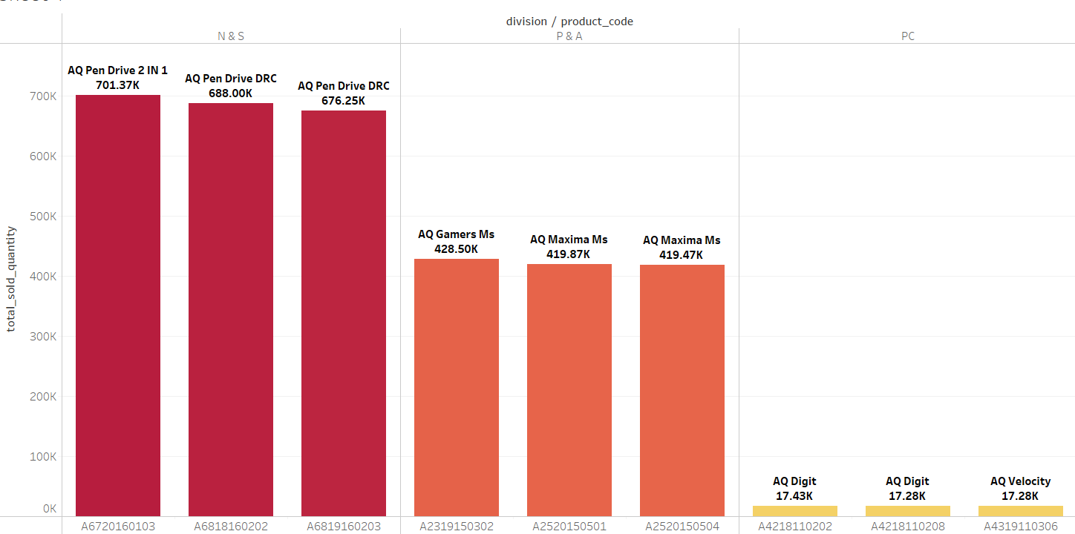
AD-HOC REQUESTS
Request – 9
Get the Top 3 products in each division that have a high total_sold_quantity in the fiscal_year 2021?
INSIGHTS
In 2021 N & S division led with highest sold quantity.
The P & A division showed consistent sales among its top 3 products.
Meanwhile, the PC division had significantly lower sales, with best products reaching just 17.43 K.

Slide 18


